Slide 1
A Theory of Island Semi-Accessibility: the Case of the Strong/Weak Distinction
Whitney Tabor, Sandra Villata, and Jon Sprouse
University of Connecticut
Talk given March 19, 2020 at the CUNY Sentence Processing Conference, (virtually at) Amherst, MA
Notes:
Each time talking about positions in the network, put up the figure.

Slide 2
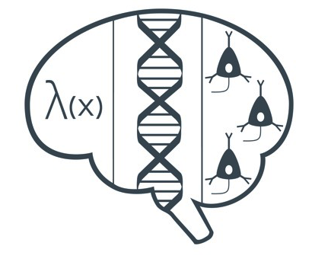

Acknowledgements
This work has been supported by a postdoctoral grant to Sandra Villata from the Marica de Vincenzi Foundation as well as by research grants from the Institute for Brain and Cognitive Sciences (IBACS), University of Connecticut and the Neurobiology of Language Program (NBL), University of Connecticut.
and YOU!
UConn IBACS
UConn NBL

Slide 3
Overview
Reliable, fine-grained measurements of grammaticality and processing are becoming well established enough to support formalized theories of grammar/processing.
Islands are a case of particular interest. We focus on the strong-weak distinction.
Foundational observation: Weak islands…
…show evidence of being islands.
…allowing some linking of gaps across island boundaries.
Self-Organized Sentence Processing (SOSP), a nonlinear dynamical systems approach to grammar/processing offers insight.

Slide 4
The Data
Subject Island Extractions (Strong)
(a) * Who_{i} does the retiree think [the speech by t_{i} ] interrupted the show? (Simple [Bare] Wh-element)
(b) * Which politician_{i} does the retiree think [the speech by t_{i} ] interrupted the show? (Complex [Discourse-linked] Wh-element)
(2) because-Adjunct Island Extractions (Strong)
(a) * What_{i} did the brothers wink [because the sisters abhored t_{i} ]? (Simple Wh-element)
(b) * Which snack_{i} did the brothers wink [because the sisters abhored t_{i} ]? (Complex Wh-element)
Judgments (“*”, “ “, “?”) indicate traditional linguistic judgments
Square brackets [ ] mark the island structures

Slide 5
The Data
(3) Whether Island Extractions (Weak)
* What_{i} does the detective wonder [whether Alice
stole t_{i} ]? (Simple Wh-element)
(b) Which necklace_{i} does the detective wonder [whether
Alice stole t_{i} ]? (Complex Wh-element)
(4) Complex NP Island Extractions (Weak)
* What_{i} did you hear [the rumor that Jeff baked t_{i} ].
(Simple Wh-element)
(b) ? Which pie_{i} did you hear [the rumor that Jeff
baked t_{i} ]? (Complex Wh-element)
Evaluations (“*”, “ ”, “?”) indicate traditional linguistic judgments
Square brackets [ ] mark the island structures

Slide 6
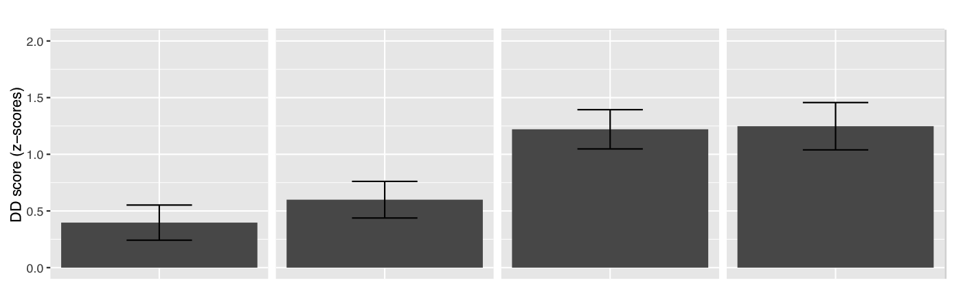
The Data
WEAK STRONG
Whether CNP Subject Adjunct
Difference of difference scores from Likert scale acceptability judgments on complex (D-linked) islands and controls in Sprouse & Messick (2015)---see also Sprouse et al. (2016). Each bar indicates the residual disapproval of an island violating sentence, after
plausible processing effects have been subtracted out.

Slide 7
The Data
Villata, Sprouse, & Tabor poster (12:10-2pm today) on Maze Task evidence for filler-gap linking in the two weak islands, Whether and Complex-NP, but not in (strong) Adjunct Islands.

Slide 8
The Data’s Challenge
(1) Complex Whether and Complex CNP Islands are islands (they show the characteristic interaction which indicates an effect of grammar)
(2) They also allow extraction at least some of the time.
Current clearest formal theories of islands say: either an element can be extracted or it can’t.
This seems like a paradox.

Slide 9
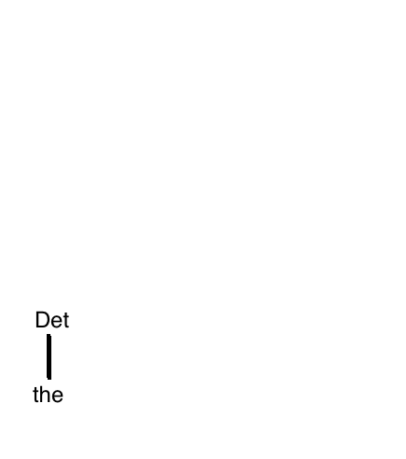
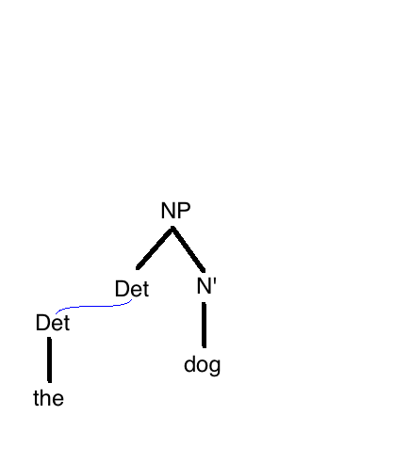
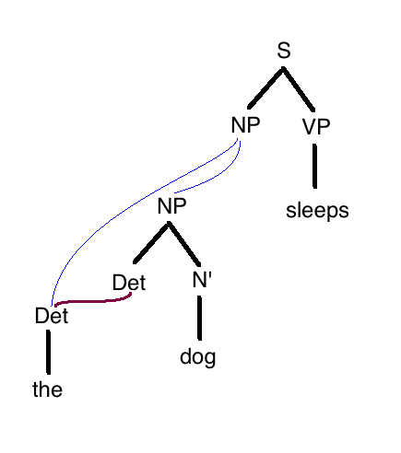
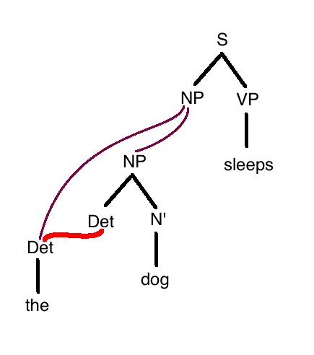
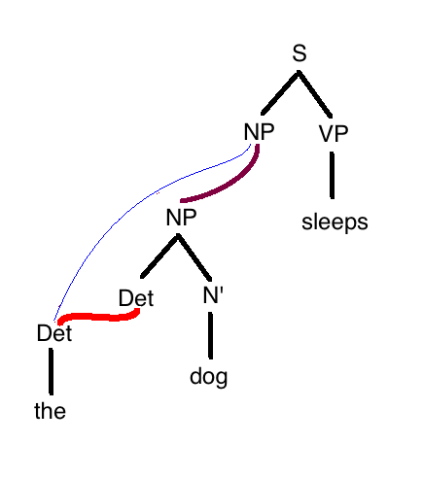
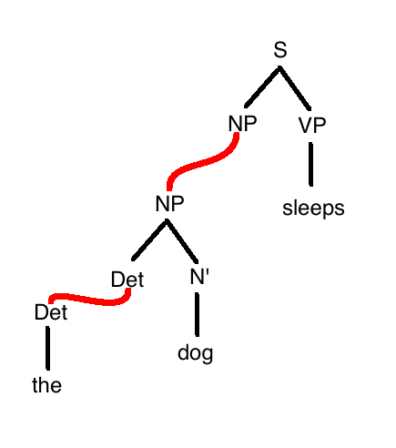
Self-Organized Sentence Processing (SOSP):

Slide 10
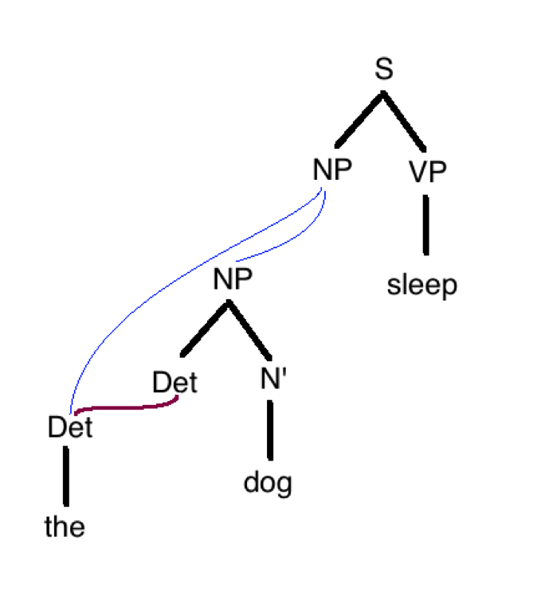
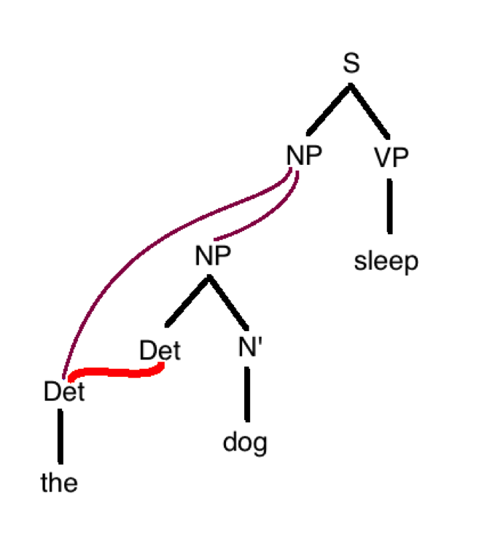
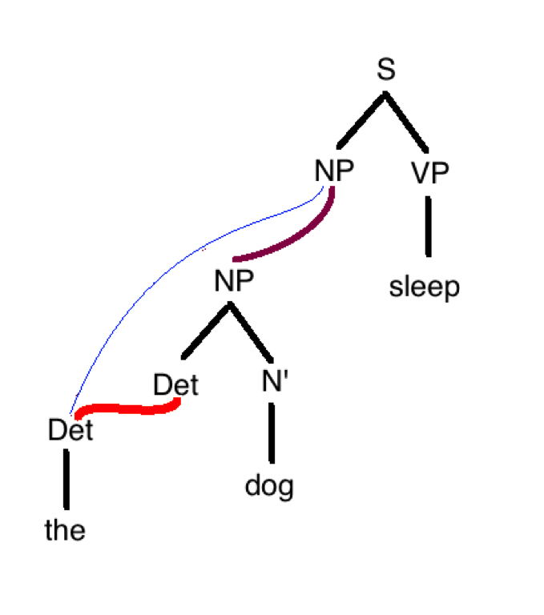
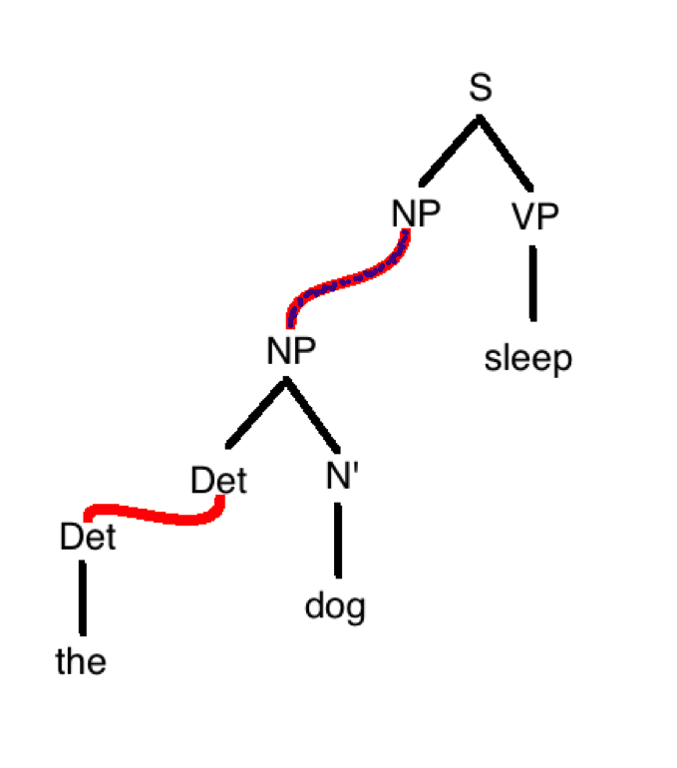
Self-Organized Sentence Processing (SOSP):
Note: the SOSP solution to the seeming paradox of graded islandhood is consistent with Kalyan (2012) and Ambridge (2015) (see also Ambridge & Goldberg, 2008)---it integrates their notion of word <-> construction fit with a parsing model.

Slide 11
Self-Organized Sentence Processing (SOSP):
Note: The model descibed here is a very close relative of Gradient Symbolic Computation (GSC) approaches (e.g., Cho, Goldrick, Smolensky, 2017, 2018). See particularly the poster by Pyeong-Whan Cho in Poster Session A of this CUNY.

Slide 12
Testing the theory: a computational exploration
We have built some simple differential equation models of coercion that show how Self Organized Sentence Processing (SOSP) produces observed effects (Villata, Sprouse, & Tabor, 2019)
These models simply assume that the relevant semantic feature arrays are close enough to parsable structures that they can be coerced into them.

Slide 13
Testing the theory: a computational exploration
What is the theory of closeness?
We explore the structural part of this (Strong vs. Weak), [not the Complex vs. Simple distinction] here.
We use traditional computational linguistics resources to assess the plausibility of the self-organizing account.

Slide 14
Testing the theory: a computational exploration
A lexical dependency grammar for English (long-distance dependencies via slash-passing [Gazdar, 1981]):
  Root → WhQ
  WhQ → N[wh] V/N
  think [V] → N C
  think [V/N] → N C/N
  that [C] → V
  that [C/N] → V/N
  wonder [V] → N C
  whether [C] → V
  …

Slide 15
Testing the theory: a computational exploration
“Which book_{i} does Jeff think that Brett adores t_{i} ?”

Slide 16
Testing the theory: a computational exploration
[V/N]
[V/N]
[N]
[N]
[V/N]
[V/N]
Semantically quite close
Subject of ”wonder” entertains the truth/falsehood of its complement.
Subject of “think” is fairly certain of the truth of its complement.

Slide 17
Summary of the method
Step 1: Dependency grammar with slash-passing
Step 2: Grammar for language + Mini-grammars for errant constructions (Whether, CNP, Subject, Adjunct Islands)
Step 3: Identification of unlicensed elements in mini-analyses with respect to language, extraction of structural context
Step 4: Discovery of alternative structures by finding parallel licensed fragments
Step 5: Comparison of the semantics of licensed with unlicensed fragments to measure “closeness”

Slide 18
Summary of the method
Step 1: Dependency grammar with slash-passing
Step 2: Grammar for language + Mini-grammars for errant constructions (Whether, CNP, Subject, Adjunct Islands)
Step 3: Identification of unlicensed elements in mini-analyses with respect to language, extraction of structural context
Step 4: Discovery of alternative structures by finding parallel licensed fragments
Step 5: Comparison of the semantics of licensed with unlicensed fragments to measure “closeness”

Slide 19
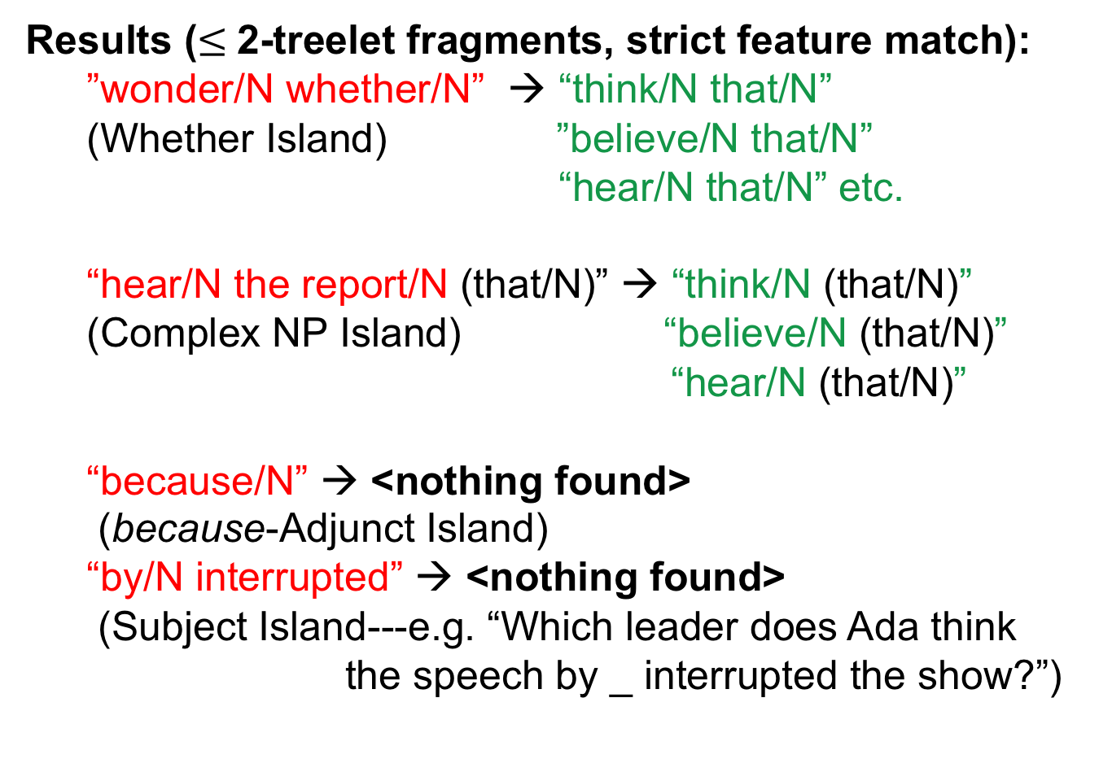
Testing the theory: a computational exploration
Results ($≤$2-treelet fragments, strict feature match):
  ”wonder/N whether/N” → “think/N that/N”
  (Whether Island) ”believe/N that/N”
  “hear/N that/N” etc.
  “hear/N the report/N (that/N)” → “think/N (that/N)”
  (Complex NP Island) “believe/N (that/N)”
  “hear/N (that/N)”
  “because/N” → <nothing found>
  (because-Adjunct Island)
  “by/N interrupted” → <nothing found>
  (Subject Island---e.g. “Which leader does Ada think
  the speech by _ interrupted the show?”)

Slide 20
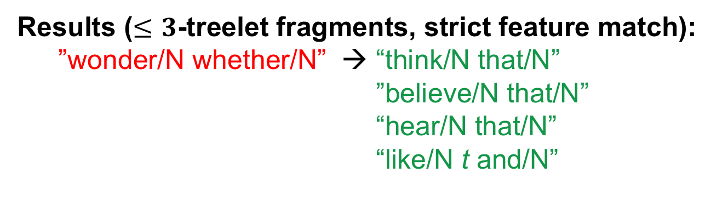
Testing the theory: a computational exploration
Results ($≤3$-treelet fragments, strict feature match):
  ”wonder/N whether/N” → “think/N that/N”
  ”believe/N that/N”
  “hear/N that/N”
                “like/N t and/N”

Slide 21
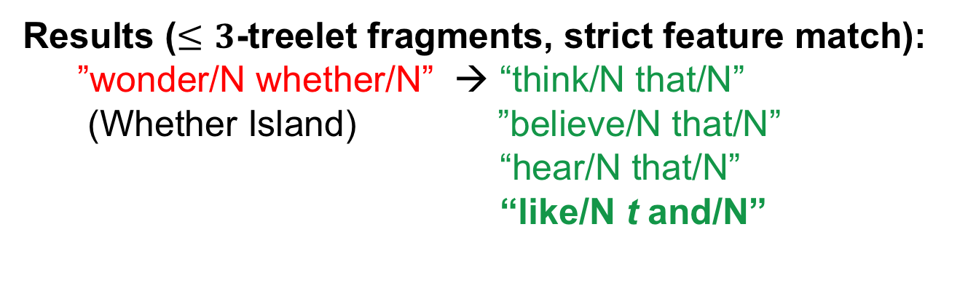
Testing the theory: a computational exploration
Results ($≤3$-treelet fragments, strict feature match):
  ”wonder/N whether/N” → “think/N that/N”
  (Whether Island) ”believe/N that/N”
  “hear/N that/N”
                “like/N t and/N”

Slide 22

Testing the theory: a computational exploration
Results ($≤3$-treelet fragments, strict feature match):
”wonder/N whether/N” → “like/N t and/N”
[V/N]
[V/N]
[N]
[V/N]
[V/N]
[N]
Semantically very different
Subject of ”wonder” entertains the truth/falsehood of its complement.
“like t and” links the object of liking to some argument of another predicate.

Slide 23
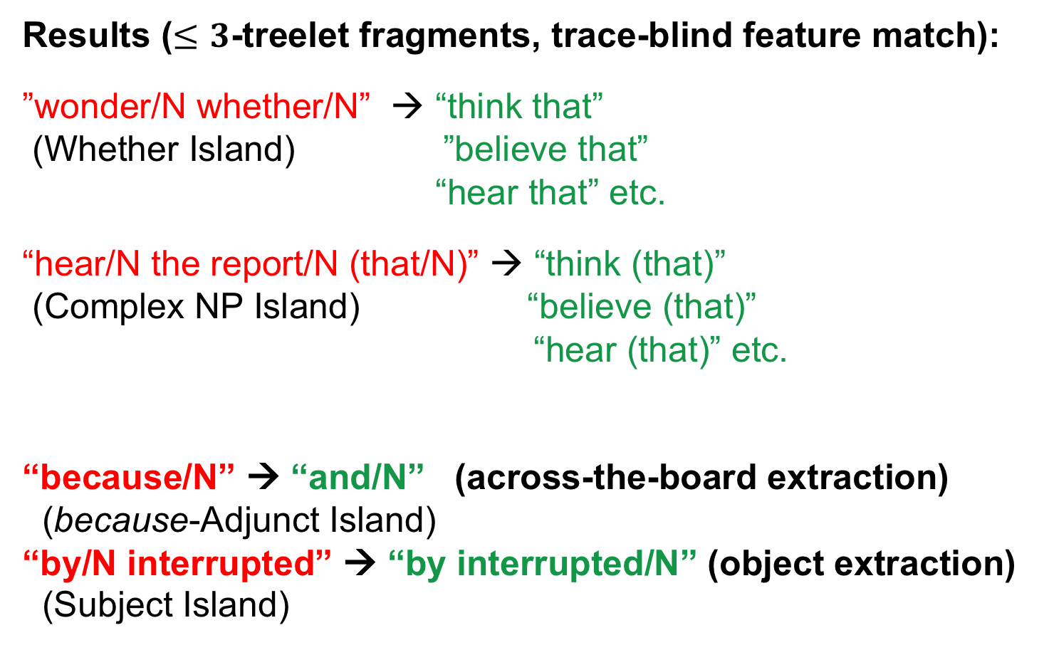
Testing the theory: a computational exploration
Results ($≤3$-treelet fragments, trace-blind feature match):
”wonder/N whether/N” → “think that”
(Whether Island) ”believe that”
“hear that” etc.
“hear/N the report/N (that/N)” → “think (that)”
(Complex NP Island) “believe (that)”
“hear (that)” etc.
“because/N” → “and/N” (across-the-board extraction)
(because-Adjunct Island)
“by/N interrupted” → “by interrupted/N” (object extraction)
(Subject Island)
Semantically very different

Slide 24
Conclusions
Graded grammaticality may not be due entirely to processes outside grammar, but may be partly the result of integrating lexically-encoded grammatical constraints.
Crucially, the coercion account assumes that attachment sites lie in a vector space (aligned with NLP “word embedding” techniques for vector encoding of grammatical situations).
The proximity that underlies coercion lies in the realm of what we standardly think of as “semantics”.
A careful integration of linguistic insights with psycholinguistic data supports the formal modeling of grammatical AND ungrammatical processing.

Slide 25
Bibliography
Ambridge, B. (2015). Island constraints and overgeneralization in language acquisition. Cognitive Linguistics, 26(2): 361–370.
Ambridge, B. & Goldberg, A. E., (2008). The island status of clausal complements: Evidence in favor of an information structure explanation. Cognitive Linguistics 19(3). 357–389.
Cho, P. W., Goldrick, M. A., & Smolensky, P. (2017). Incremental parsing in a continuous dynamical system: Sentence processing in gradient symbolic computation. Linguistic Vanguard, 3, 76-96.
Cho, P. W., Goldrick, M., Lewis, R., & Smolensky, P. (2018). Dynamic encoding of uncertainty in gradient symbols. To appear in Proceedings of the 8th Workshop on Cognitive Modeling and Computational Linguistics (CMCL 2018).
Gazdar, G. (1981). On syntactic categories. Philosophical Transactions (Series B) of the Royal Society, 295, 267-83.
Kalyan, S. 2012. Similarity in linguistic categorization: The importance of necessary
properties. Cognitive Linguistics 23(3). 539–554.
Smith, G. & Tabor, W. (2018). Toward a theory of timing effects in self-organized sentence processing. Proceedings of the International Conference on Cognitive Modeling 2018, Madison, Wisconsin. http://iccm-conference.org/
Sprouse, J., Caponigro, I., Greco, C., Ceccheto, C., (2016). Experimental syntax and the variation of island effects in English and ItalianNat Lang Linguist Theory. 34:307–344
Villata, S., Sprouse, J., & Tabor, W. (2019). Modeling Ungrammaticality: A Self-Organizing Model of Islands. In A.K. Goel, C.M. Seifert, & C. Freksa (Eds.), Proceedings of the 41st Annual Conference of the Cognitive Science Society (pp. 1178-1184). Montreal, QB: Cognitive Science Society. https://cognitivesciencesociety.org/wp-content/uploads/2019/07/cogsci19_proceedings-8July2019-compressed.pdf

Slide 27
Formal semantic theory shows “wonder” and “think” (likewise ”whether” and “that”) are fundamentally different.
Eg. Theiler, Roelofsen & Aloni (2019)
[[believe]] = λPT .λx.λp. ∀w ∈ p. (DOX^{w}_{x} ∈ P ∨ DOX^{w}_{x} ∈ in(P)). ∀w ∈ p. DOX^{w}_{x} ∈ P
[[wonder ]]= λPT .λx.λp. ∀w ∈ p. (DOX^{w}_{x} ∈
P ∧ INQ^{w}_{x} ⊆ P)
How can we claim they are similar?

Slide 28
Other examples
Which book did Jeff take a vacation in order to read _ ? (purpose Adjunct)
Which book did Julia finish sketches and buy _ ? (progressive Adjunct, [Brown, 2017])
Which painting did Monica travel to New York and buy _ ? (“Type A” Coordination [Lakoff, 1986]---cf. Neeleman & Tanaka ms on Lingbuzz)

