Slide 1
On the relationship between syntactic and semantic encoding in vector space language models
Whitney Tabor
University of Connecticut
Haskins Laboratories
Talk at SemSpace 2020, August 6, 2020

Slide 2
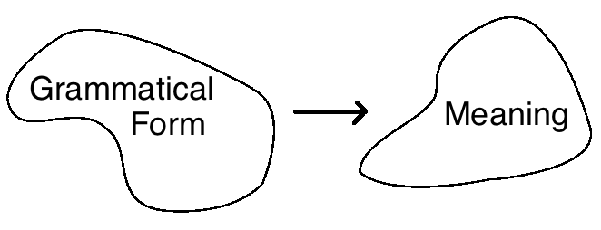
What is grammaticality? How is it related to meaning?
An early view (Chomsky, 1957):
(1a) Colorless green ideas sleep furiously. (+syn, -sem)
(1b) Furiously sleep ideas green colorless. (-syn, -sem)
(1c) Those dog that barking all night lonely (-syn, +sem)
(1d) Some cats that live in high-rises are content (+syn, + sem)
Motivates:
Grammatical form = well-formed formulas

Slide 3
What is grammaticality? How is it related to meaning?
Standard view says (1c) is uninterpretable…
An early view (Chomsky, 1957):
(1a) Colorless green ideas sleep furiously. (+syn, -sem)
(1b) Furiously sleep ideas green colorless. (-syn, -sem)
(1c) Those dog that barking all night lonely (-syn, +sem)
(1d) Some cats that live in high-rises are content (+syn, + sem)
Motivates:
Grammatical form = well-formed formulas

Slide 4
New proposal
In the mind, there is only one space:
X = Syntax-Semantics
This space is a complete metric space on which a dynamical system is defined
x(t+1) = f(x(t)) (t is discrete time)
Two differences from most preceding theories:
Only one space, mapped to itself: f: X → X
The space is a continuum
For example, a complete, normed vector space
Like
Dynamic
Syntax
(Kempson
et al. 2001)
Like other
vector space
lg models

Slide 5
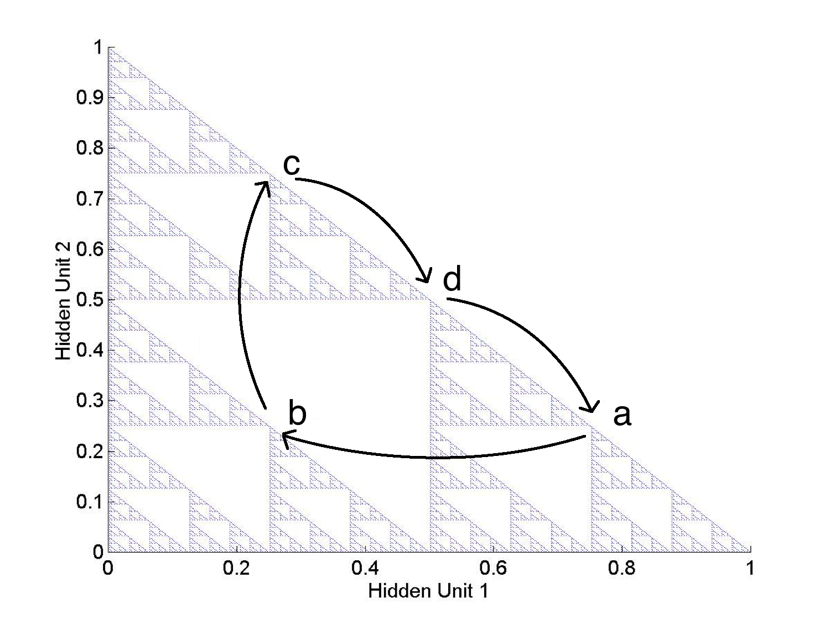
How does this work?
Semantic encodings are recursively compositional.
Therefore, use recursive sets
---i.e. fractals.
Each point is a mental state.
Word-by-word processing =
discrete update of mental state---i.e. dynamics.
An important practical property: stability
How does this handle the tricky cases above?
+syn, -sem: minor perturbation
-syn, +sem: major perturbation
Note: these are recurrent neural networks (RNNs)

Slide 6
The proposal in more detail…

Slide 7
Formal languages
Consider a finite vocabulary, $Σ$.
$Σ^{∗}$ = finite strings drawn from $Σ$
${L: Σ}^{∗}→\{0, 1\}$ is a (standard) formal language (i.e., set of finite strings drawn from a finite alphabet)
A generalization:
${L: Σ}^{+∞}→\left\{0, 1\right\}$ (i.e., set of one-sided infinite strings drawn from a finite alphabet)

Slide 8
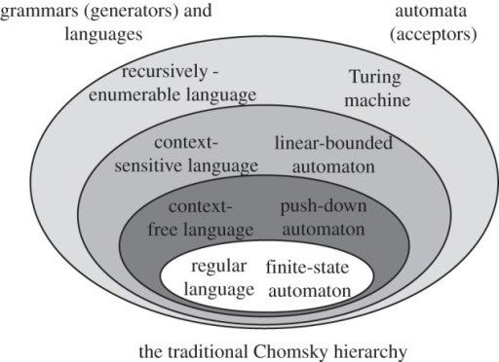
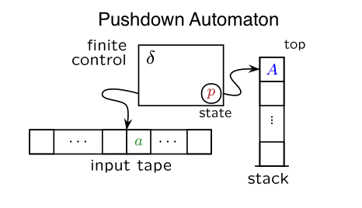
Chomsky Hierarchy and Pushdown Automata

Slide 9
Fractal grammars: how vector space computers (RNNs) can do recursion
A grammar: S → A B C D
A → a (S)
B → b (S)
C → c (S)
D → d
Eg. [a b [a b c d] c d]
[a b c [a [a b c d] b c d] d]
Recall:
Note: stack states = all strings formed from {A, B, C}

Slide 10
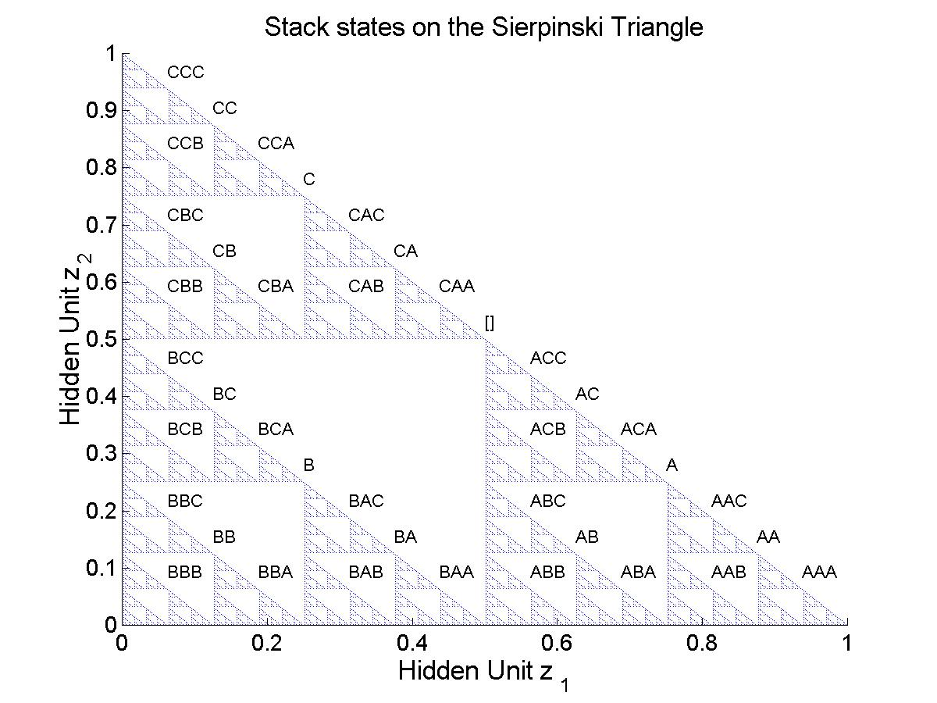
Stack Map

Slide 11
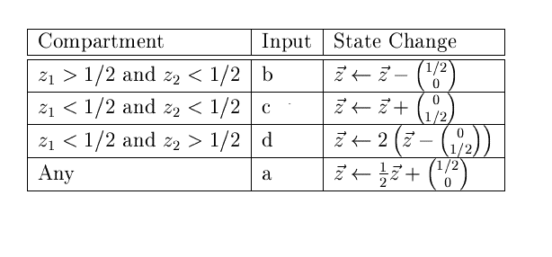
Input Map
Note: all these functions are affine f(z) = az + b

Slide 12
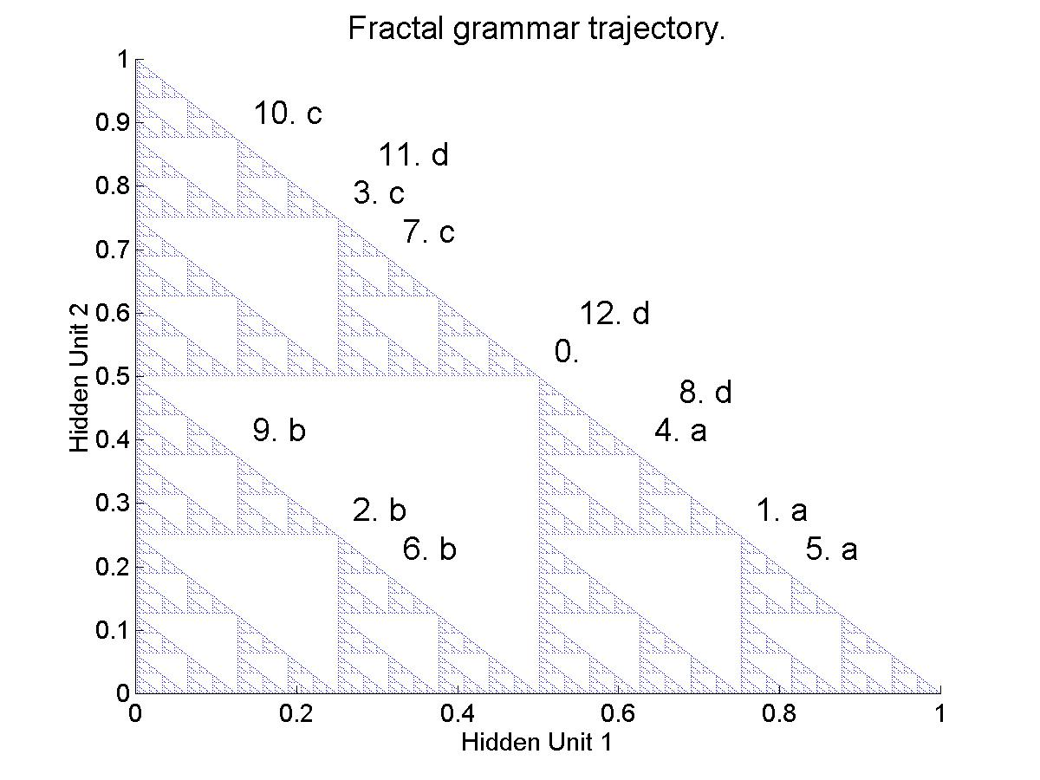
Sentence Processing on Fractal
[a b c [a [a b c d] b c d] d]

Slide 13
Computational Power of Fractal Computing
Thm. (Siegelmann & Sontag, 1994) Neural networks with rational weights can emulate Turing Machines (via affine fractal encoding)
Thm. (Moore, 1998). Any context free language can be processed by a one-dimensional dynamical “recognizer” with affine transfer functions. (using affine fractal encoding)
Thm. (Tabor, 2000). Any context free language can be processed with an (affine) fractal grammar.

Slide 14
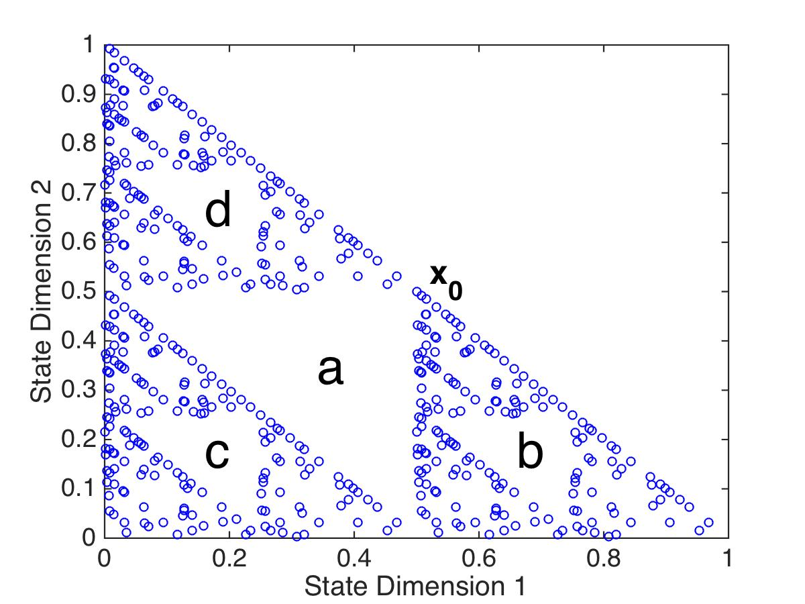
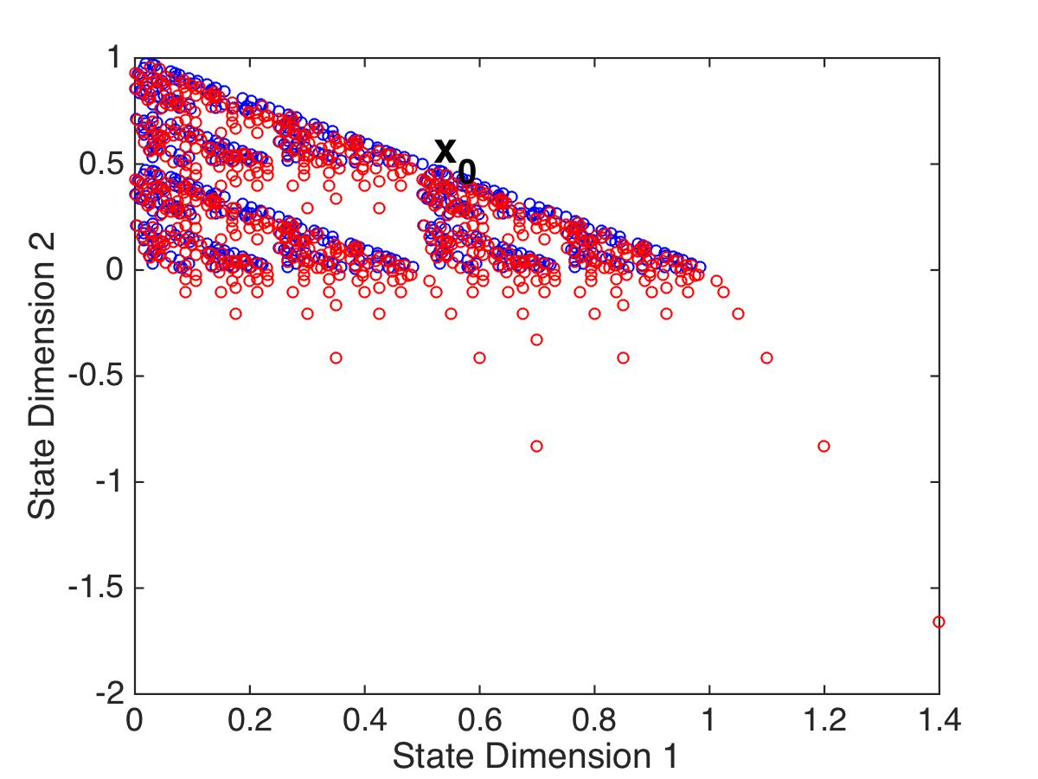
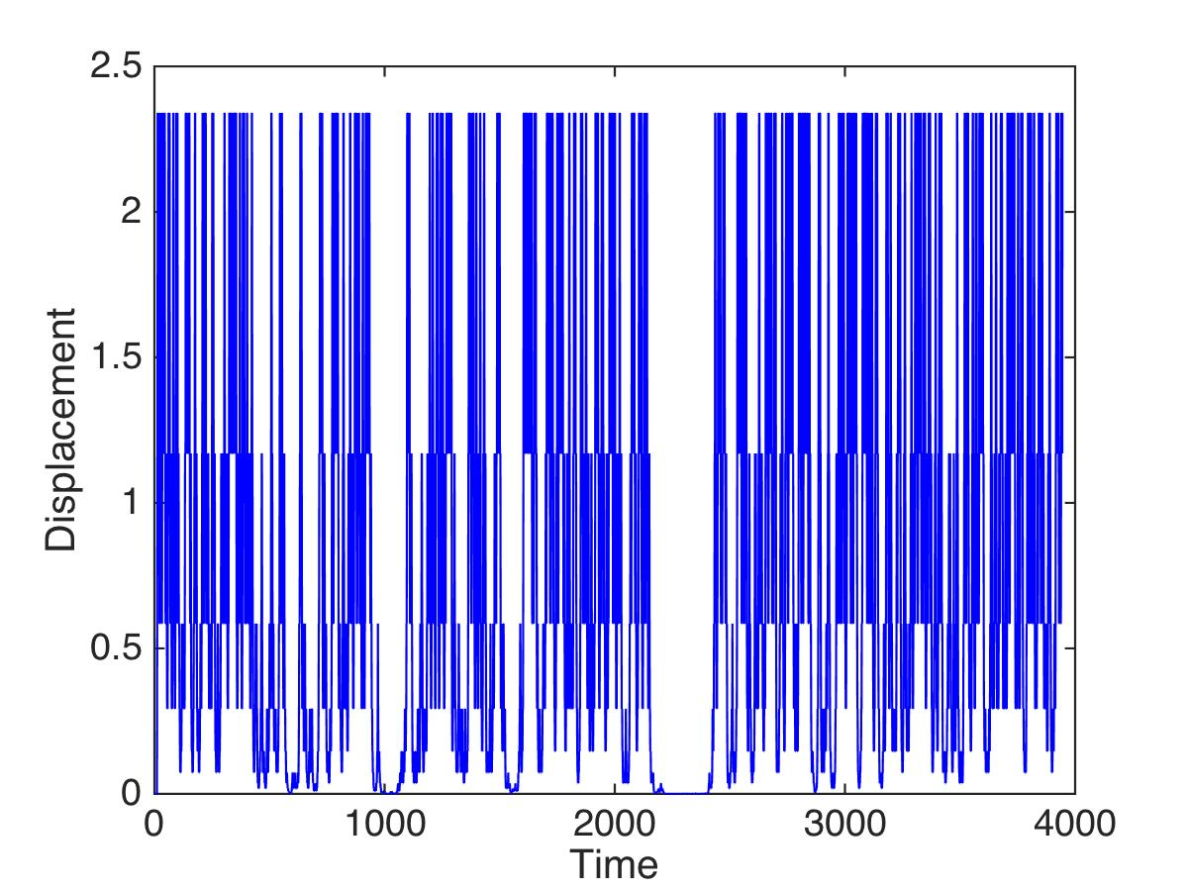
A weakness of affine fractal grammars: lack of stability
The future of x₀ (no noise)
The future after one perturbation
o = unperturbed
o = perturbed
Tabor (2000) --- fractal grammar for ABCD language.
Displacement from the unperturbed future across time.

Slide 15
Back in Kansas Stability
Def. Consider an iterated function system on a complete metric space X with functions Σ = {1,…, k} and a one-sided infinite string language L on Σ. Let GM be the grammatical manifold associated with initial state x₀ and labeling Lab_{x0}. If, upon pertur- bation within a radius δ of a point in GM the system, being driven by any grammatical future, converges to GM with correct labeling, then we say it exhibits Back in Kansas Stability. We say that the points in GM along with their labels, are an attractor of IFS-L.
i.e., back in the normal environment long enough → normal life resumes

Slide 16
An important type of grammar for natural language: mirror recursion
Consider one-sided infinite concatentations from
S → a S b
S → x S y
S → a b
S → x y
This is a case of mirror recursion.
Examples:
a x y b (cf. “the cow_{a} that the dog_{x} chased_{y} mooed_{b}”)
x x a b y y
Mirror recursion is an important form of recursion in natural language (Corbalis, 2007)

Slide 17
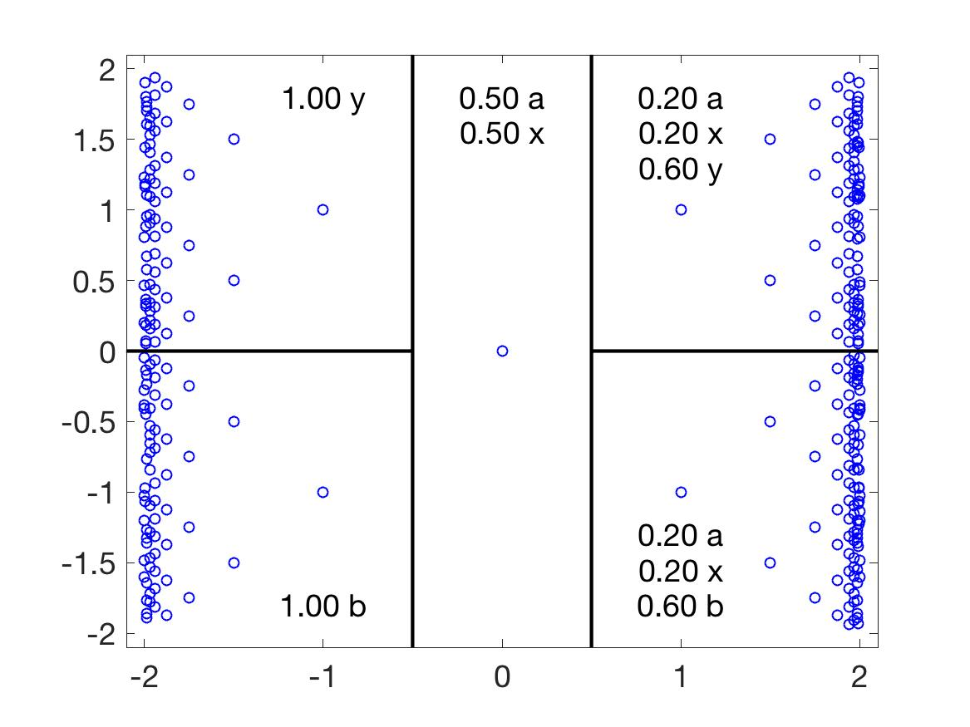
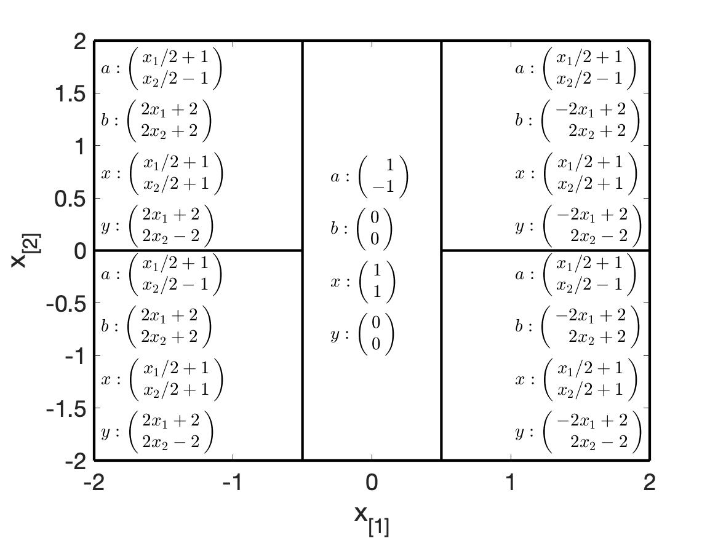
A Back in Kansas (BIK)-stable system that does mirror recursion
Not affine, but quadratic!
Result: the system is globally BIK-stable

Slide 18
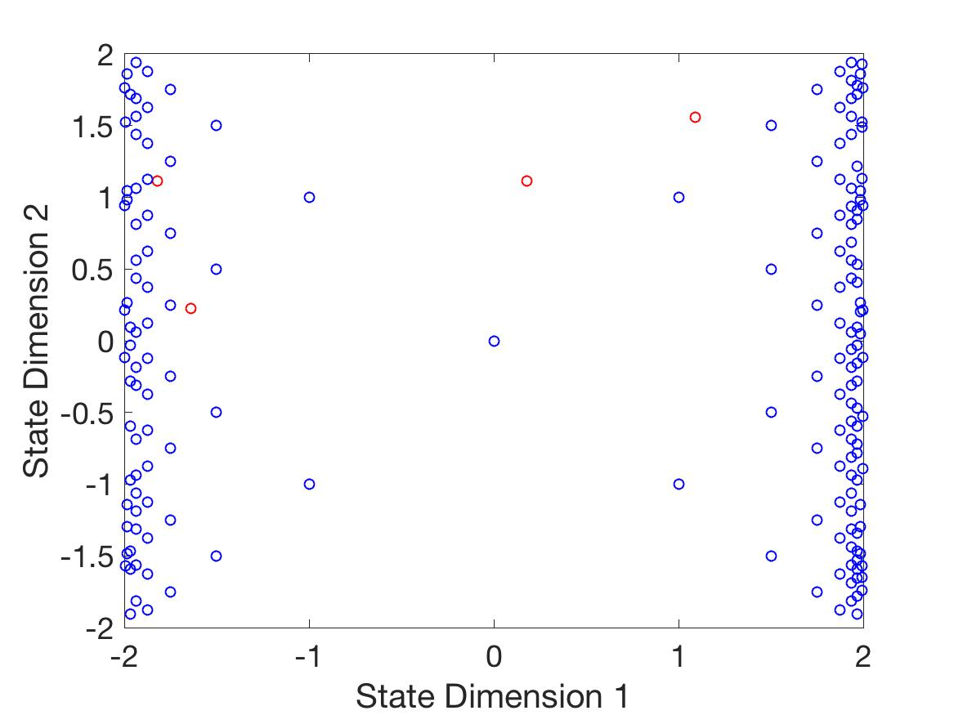
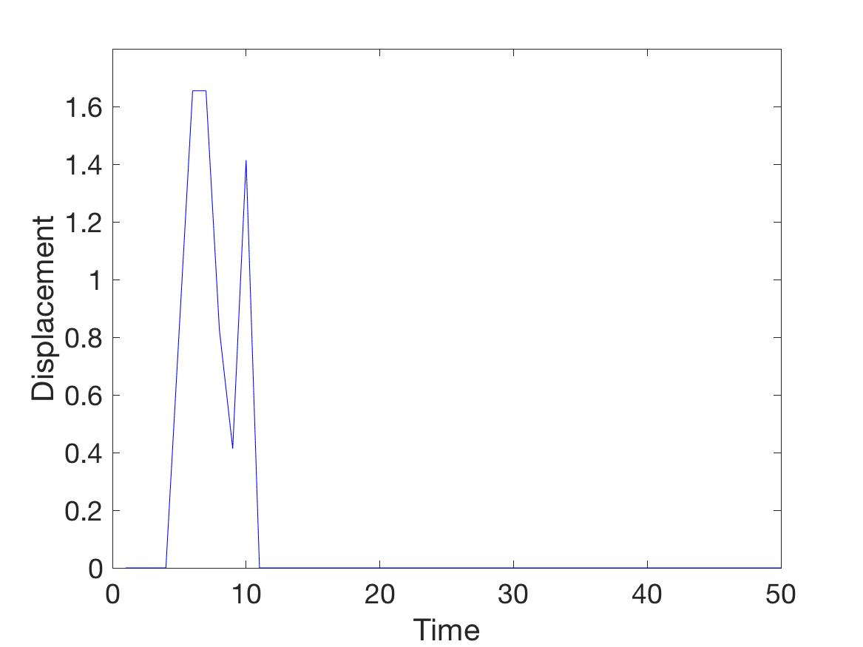
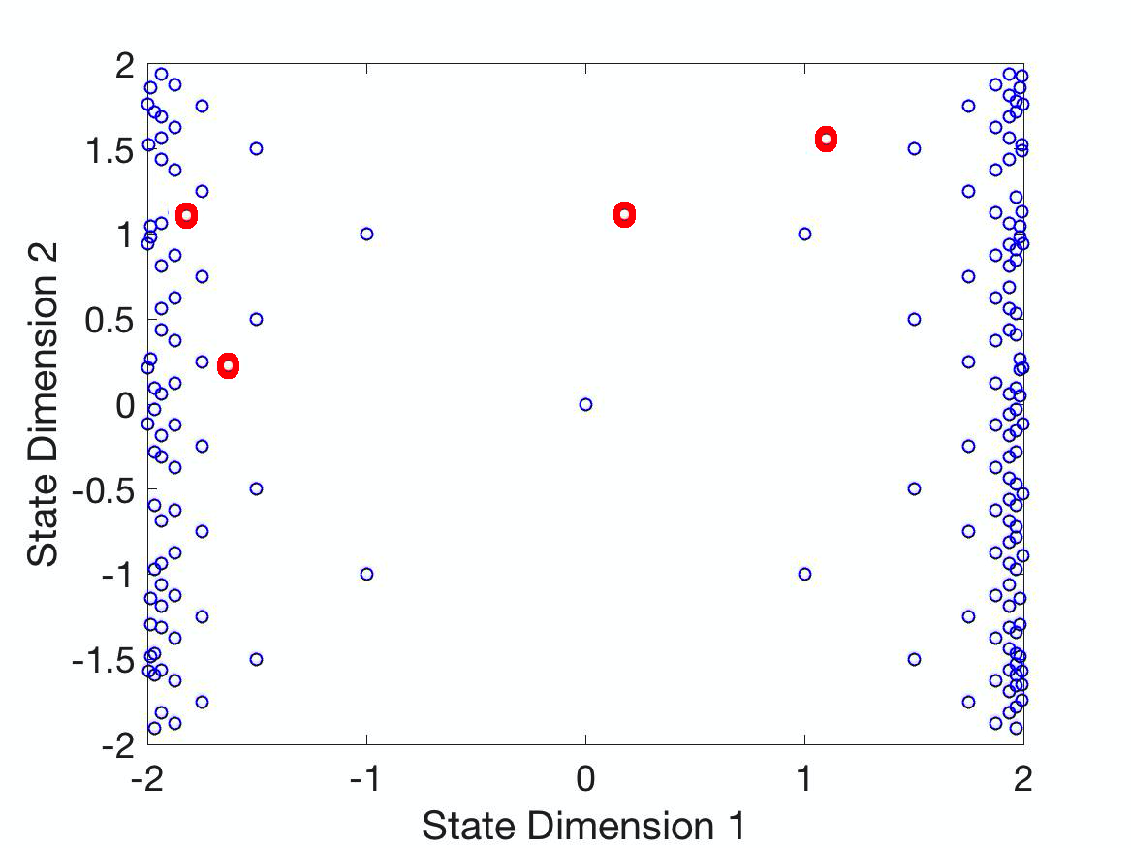
Illustration of BIK stability for simple mirror recursion
Random perturbation after a few time steps
Displacement is large at first, but disappears

Slide 19
Def. Syntactically acceptable perturbation
Suppose the system, in processing a grammatical string is perturbed from the grammatical manifold to a point near the manifold. If, under every grammatical future from that point on, the system’s predictions are aligned with the symbol sequence, then the perturbation is called syntactically acceptable.
Note: We will take this as a model of semantic violation that is not syntactic violation (like
(1a) “colorless green ideas sleep furiously”)

Slide 20
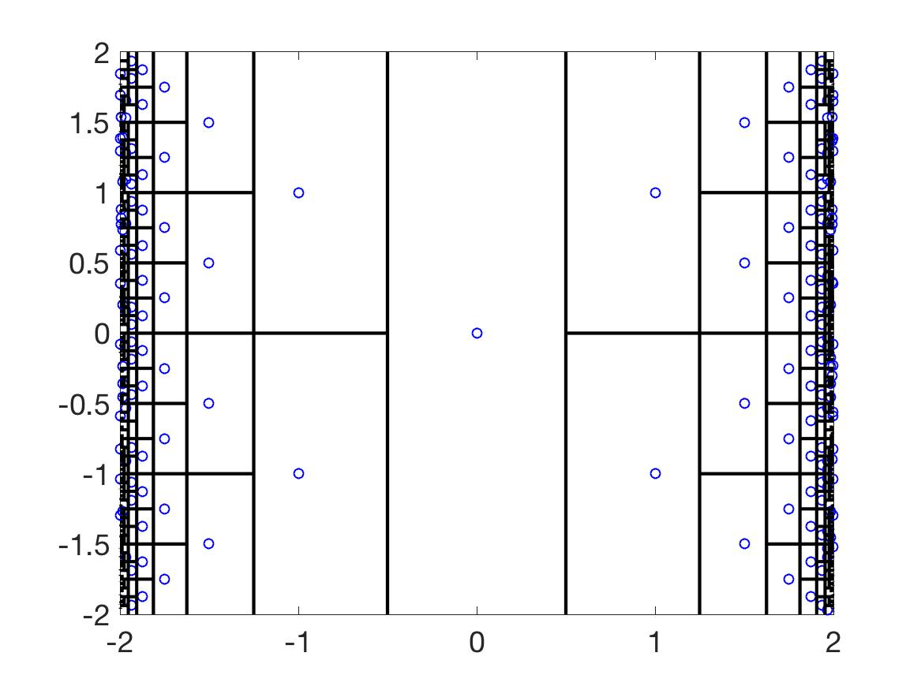
Result: There exists an open acceptable basin
Iff a perturbation from one of the blue points does not surpass its black box, then all and only grammatical futures will be expected.

Slide 21
FG-semantic anomaly and FG-syntactic anomaly
FG-semantic anomaly = perturbation within the open acceptable basin
FG-syntactic-anomaly = perturbation outside of the open acceptable basin
CLAIM: FG-semantic anomaly and FG-syntactic anomaly are good models of natural language (NL) semantic and syntactic anomaly, respectively

Slide 22
Assessing FG-semantic anomaly = NL-semantic anomaly
Fred drank water. > Fred drank syrup > Fred drank motor oil > Fred drank ball bearings > Fred drank a tree
Point: semantic anomaly shades gradually away from the ordinary

Slide 23
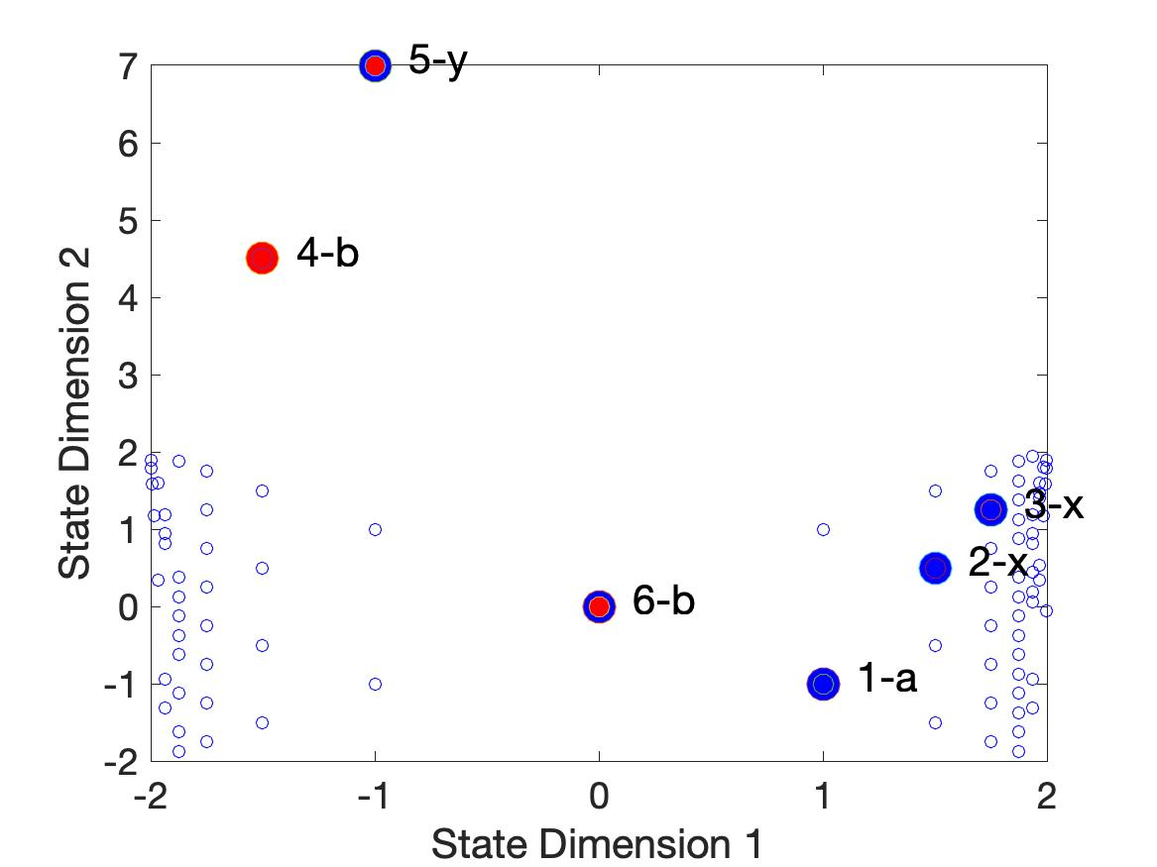
Assessing FG-syntactic anomaly = NL-syntactic anomaly
Test string: axxbyb (ungram---cf. axxyyb)
Cf:
“Those dog that barking all night lonely”
Point: coherent syntactic anomaly produces a coherent response

Slide 24
Conclusions
Summary: stable fractal grammars offer a new way of thinking about the nature of grammaticality
Benefits: simpler---unified syntax and semantics, grammatical and ungrammatical, + gradience!
Challenges:
---the examples are not very rich (cf. e.g., Cann et al., 2005; see also Villata, et al, 2019)
---need to handle semantic memory
We think this new approach bears further looking into.

Slide 25
Acknowledgedments
Thanks!
NSF 1246920
University of Connecticut
University of Illinois.
Any opinions, findings, and conclusions or recommendations expressed in this material are those of the author(s) and do not necessarily reflect the views of the National Science Foundation.

Slide 26
Bibliography
Cann, R., Kaplan, T., & Kempson, R. (2005). Data at the grammar-pragmatics interface: the case of resumptive pronouns in English. Lingua, 115: 1551-1577.
Chomsky, N. (1957). Syntactic structures. The Hague: Mouton and Co.
Corballis, M. C. (2007). Recursion, language, and starlings. Cognitive Science, 31, 697–704.
Moore, C.: Dynamical recognizers: Real-time language recognition by analog computers. Theoretical Computer Science 201, 99{136 (1998)
Siegelmann, H., & Sonntag, E. (1994). Analog computation via neural networks. Theoretical Computer Science, 131: 331.
Tabor, W. (2015). Fractal grammars which recover from perturbation. In Proceedings of the NIPS workshop on cognitive computation: Integrating neural and symbolic approaches (COCO 2015). (Montreal, Canada. Published on CEUR-WS: 29-Apr-2016. ISSN 1613-0073 by Creative Commons. ONLINE: http://ceur-ws.org/Vol-1583/) (See also wp.solab.uconn.edu)
Tabor, W.: Fractal encoding of context-free grammars in connectionist net-works. Expert Systems: The International Journal of Knowledge Engineering and Neural Networks 17(1), 41{56 (2000)
Villata, S., Sprouse, J., & Tabor, W. (2019). Modeling Ungrammaticality: A Self-Organizing Model of Islands. In A.K. Goel, C.M. Seifert, & C. Freksa (Eds.), Proceedings of the 41st Annual Conference of the Cognitive Science Society (pp. 1178-1184). Montreal, QB: Cognitive Science Society. (See wp.solab.uconn.edu)

Slide 27
Supplementary slides

Slide 28
Illustration of a one-dimensional BIK-stable fractal grammar (for a^{n}b^{n}). The two-dimensional case illustrated above uses very similar forms.

Slide 29
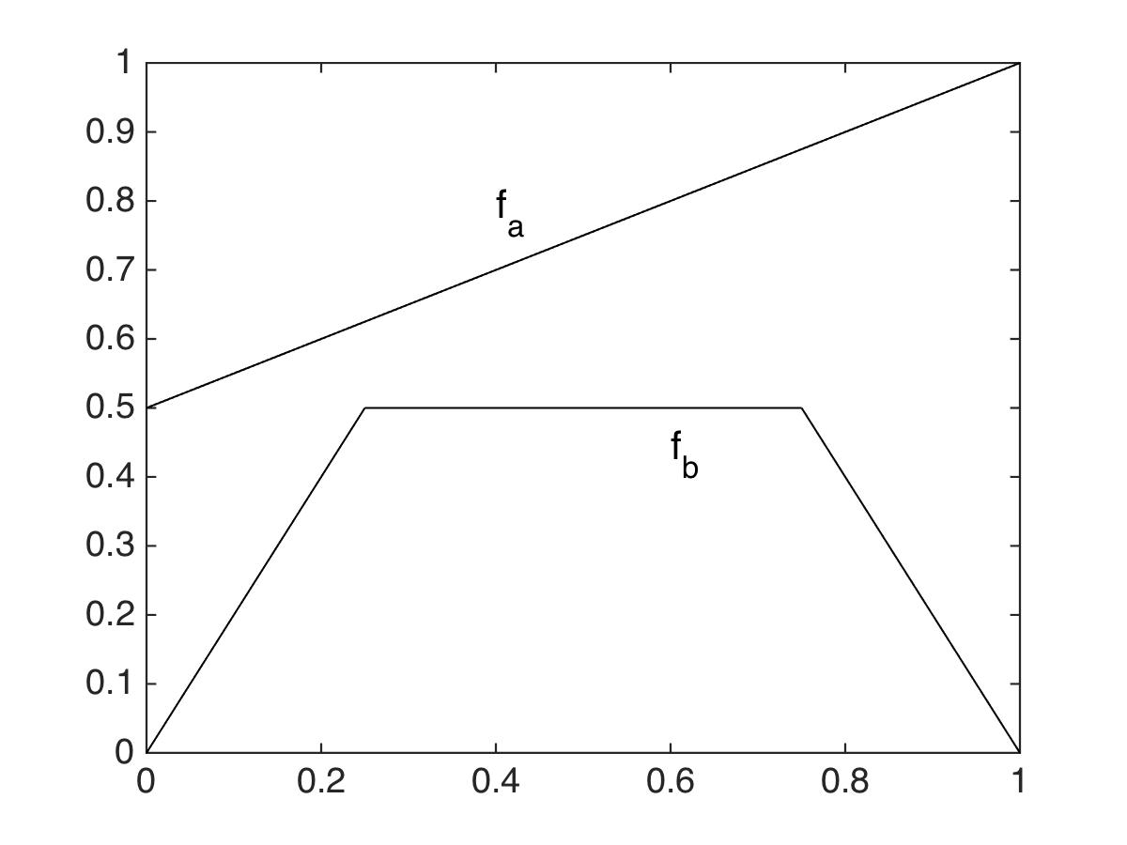
A Back in Kansas (BIK) stable fractal grammar for a^{n}b^{n}
x(0) = ½

Slide 30
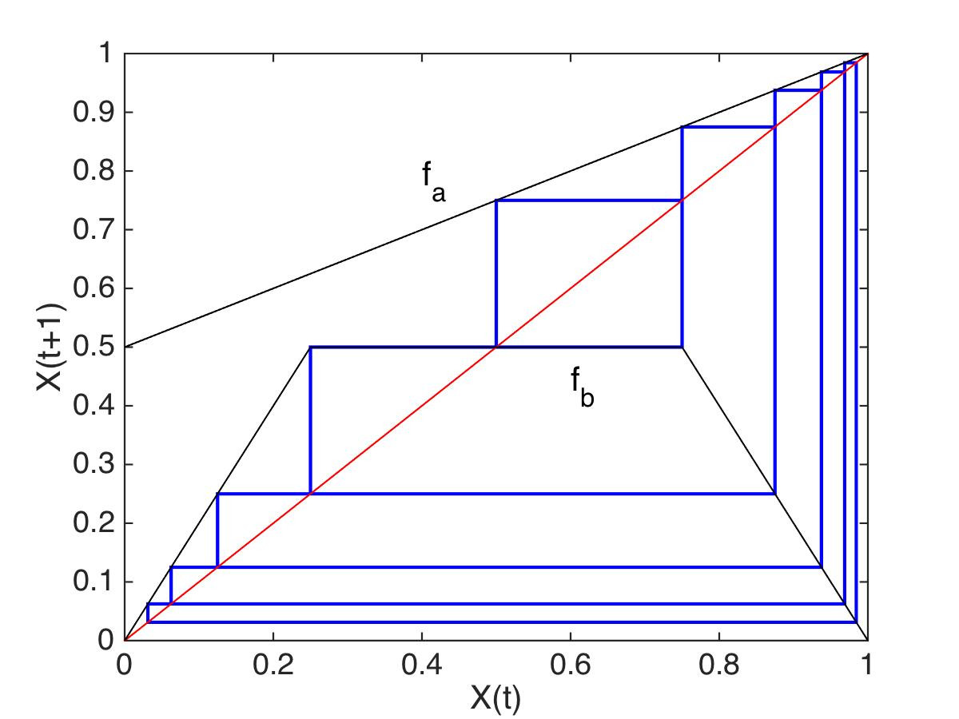
A Back in Kansas (BIK) stable fractal grammar for a^{n}b^{n}---grammatical manifold.
x(0) = ½ LF_{x(0)} = […, 1/16, 1/8, ¼, ½, ¾, 7/8, 15/16, …]

Slide 31
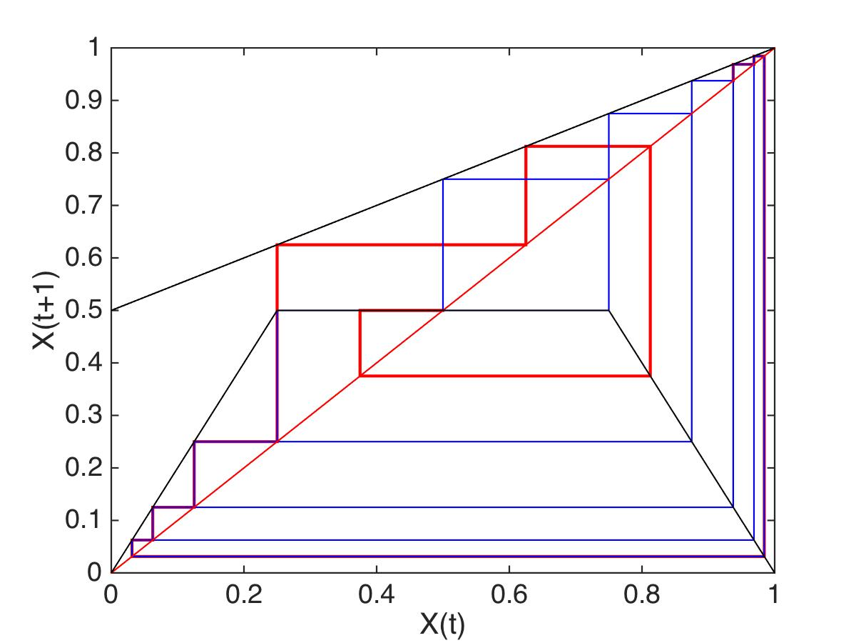
A Back in Kansas (BIK) stable fractal grammar for a^{n}b^{n}---recovery from perturbation

